Slide 1

DEEP PACKET INSPECTION
Present by Aylin Aydın

Slide 2

Skype
Skype is the first peer-to-peer VoIP application that has gained substantial popularity since its launch in 2003.
Skype also offers application programming interface which can be used by third party applications to initiate communication in the Skype network.
The protocol's specifications have not been made publicly available by Skype and official applications using the protocol are closed-source.
The Skype network is not interoperable with most other Voice over IP (VoIP) networks without proper licensing from Skype. Numerous attempts to study or reverse-engineer the protocol have been undertaken to reveal the protocol, investigate security or allow unofficial clients.
Notes:
Skype is a software application that allows users to start and receive voice and video calls and to chat over the Internet. Also voice or video conference, and file transfers are supported. Skype also offers application programming interface which can be used by third party applications to initiate communication in the Skype network.

Slide 3
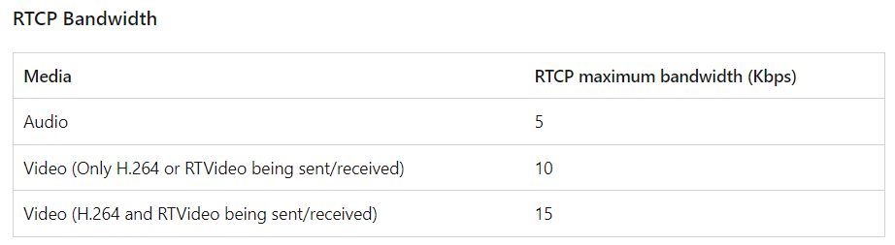
Technology and Protocols
The Skype code is closed source, and the protocol is not standardized. Parts of the client use Internet Direct (Indy), an open-source socket communication library.
Protocol detection: Pearson's chi-squared test and stochastic characterization with Naive Bayes classifiers are two approaches that were published in 2007.
Skype requires that Ports 80 and 443 be open for outgoing Transmission Control Protocol (TCP) transmissions and recommends that all destination ports above 1024 also remain open. In addition, Ports 5060 and 8000 should remain open for incoming and outgoing UDP transmissions. Skype prefers UDP for voice transmissions.
Notes:
Many networking and security companies claim to detect and control Skype's protocol for enterprise and carrier applications. While the specific detection methods used by these companies are often proprietary,
RTCP (Real-Time Transport Control Protocol)

Slide 4
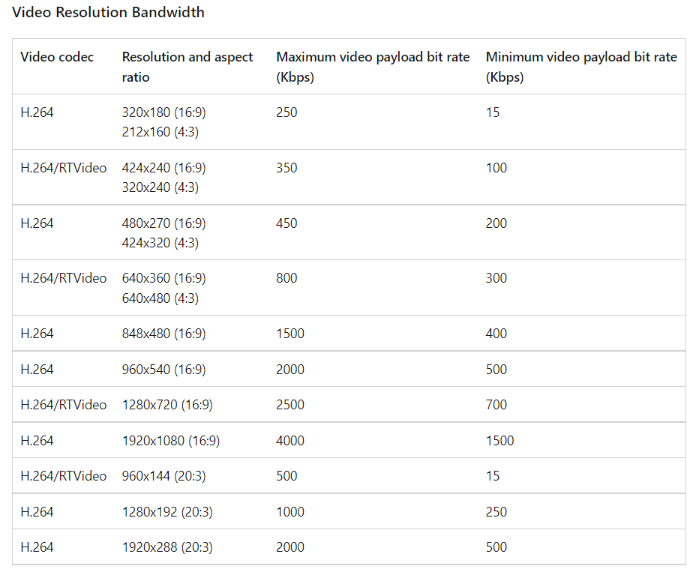
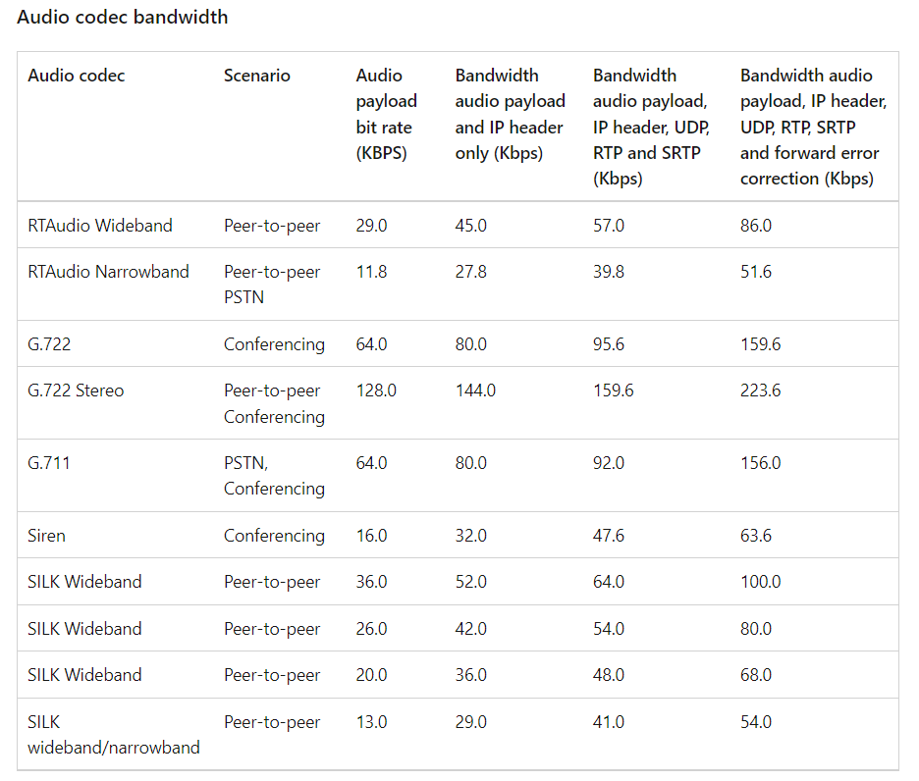
Notes:
H. 264 is a well-known video compression standard for high-definition digital video.

Slide 5
Protocol Change at 2014
On June 20, 2014, Microsoft announced the deprecation of the old Skype protocol. Within several months from this date, in order to continue using Skype services, Skype users had to update to Skype applications released in 2014, and users were not able to log in to older Skype versions (clients).
The new Skype protocol—Microsoft Notification Protocol 24—promised better offline messaging and better messages synchronization across Skype devices.
Signaling is encrypted using RC4; however, the method only obfuscates the traffic as the key can be recovered from the packet. Voice data is encrypted with AES. The protocol is proprietary, created specifically for Skype sessions, and does not work with most standard VoIP networks without licensing from Skype.
Notes:
Sinyal RC4 kullanılarak şifrelenir; Ancak, anahtar paketten kurtarılabildiğinden yöntem yalnızca trafiği karıştırır. Ses verileri AES ile şifrelenir. Protokol özeldir, Skype oturumları için özel olarak oluşturulmuştur ve Skype'tan lisans almadan çoğu standart VoIP ağıyla çalışmaz.

Slide 6
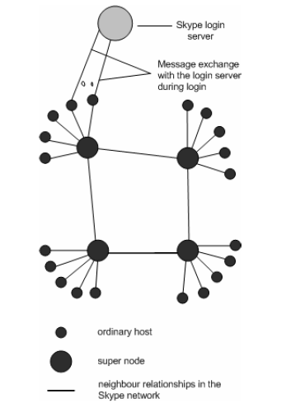
Academic and Technological Studies
A Skype client (SC) opens a TCP and a UDP listening port at the port number configured in its connection dialog box. SC randomly chooses the port number upon installation. In addition, SC also opens TCP listening ports at port number 80 (HTTP port), and port number 443 (HTTPS port). Unlike many Internet protocols, like SIP and HTTP, there is no default TCP or UDP listening port. [1]
[1] Salman A. Baset and Henning Schulzrinne (2004). An Analysis of the Skype Peer-to-Peer Internet Telephony Protocol. Page 2
Notes:
Skype istemcisi (SC), bağlantı iletişim kutusunda yapılandırılan bağlantı noktası numarasında bir TCP ve UDP dinleme bağlantı noktası açar. SC, kurulumdan sonra bağlantı noktası numarasını rasgele seçer. Ayrıca SC, 80 numaralı bağlantı noktasında (HTTP bağlantı noktası) ve 443 numaralı bağlantı noktasında (HTTPS bağlantı noktası) TCP dinleme bağlantı noktalarını da açar. SIP ve HTTP gibi birçok internet protokolünün aksine, varsayılan TCP veya UDP dinleme bağlantı noktası yoktur.

Slide 7
We observed that Skype can work almost seamlessly behind NATs and firewalls. [1]
It is by the random selection of sender and listener ports, the use of TCP as voice streaming protocol, and the peer-to-peer nature of the Skype network, that not only a SC traverses NATs and firewalls but it does so without any explicit NAT or firewall traversal server. [1]
Compared to Yahoo, MSN, and Google Talk applications, Skype reported the best mouth-to-ear latency. [1]
Theoretically speaking, if all Skype users decided to put bandwidth limiter on their application, the Skype network can possibly collapse since the SNs hosted by Skype may not have enough bandwidth to relay all calls. [1]
Notes:
Skype'ın nat'lerin ve güvenlik duvarlarının arkasında neredeyse sorunsuz çalışabileceğini gözlemledik
Gönderen ve dinleyici bağlantı noktalarının rastgele seçilmesi, TCP'NİN ses akışı protokolü olarak kullanılması ve Skype ağının eşler arası doğası gereği, yalnızca bir SC nat'leri ve güvenlik duvarlarını geçmekle kalmaz, bunu açık bir NAT veya güvenlik duvarı geçişi sunucusu olmadan yapar.
Yahoo, MSN ve Google Talk uygulamalarıyla karşılaştırıldığında Skype, ağızdan kulağa en iyi gecikmeyi bildirdi.
Teorik olarak konuşursak, tüm Skype kullanıcıları uygulamalarına bant genişliği sınırlayıcı koymaya karar verdiyse, Skype tarafından barındırılan Sn'lerin tüm aramaları iletmek için yeterli bant genişliğine sahip olmayabileceğinden Skype ağı çökebilir.

Slide 8
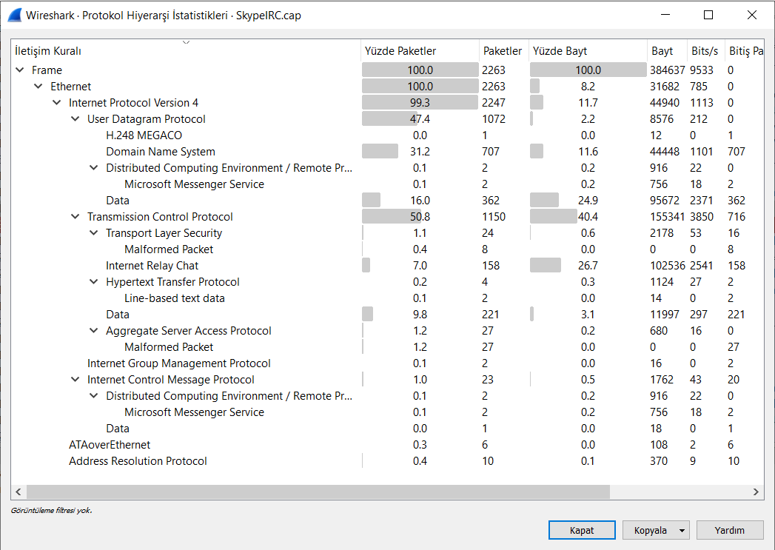
2006

Slide 9
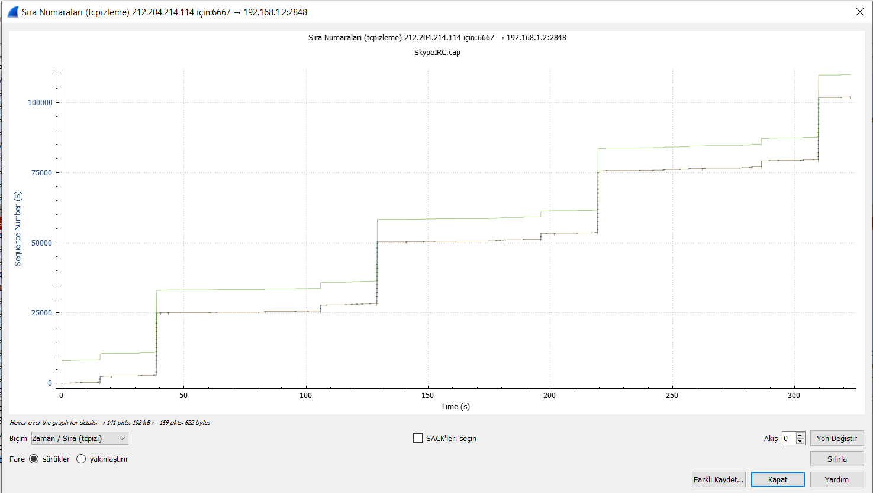
TCP Stream Graph

Slide 10
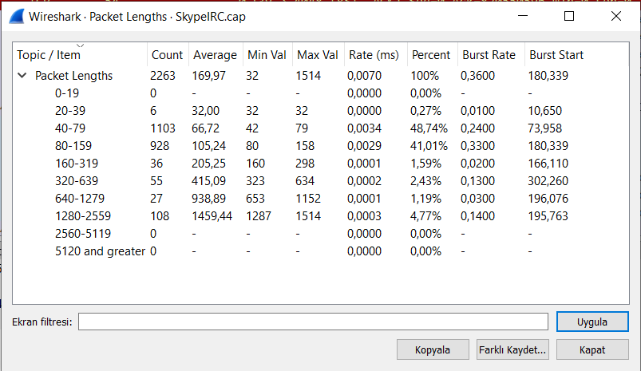
Package Behavior and Features

Slide 11
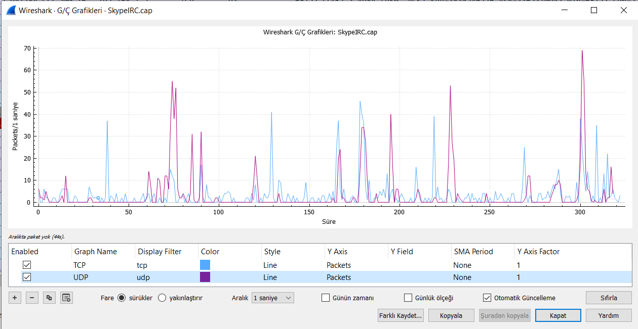
TCP and UDP Behavior

Slide 12
Experimental Setup
Wireshark has been used to capture the network traffic . A PC used to send a video call, voice call and chat message to mobile phone. PC Network traffic observed.
The captured traffic saved in pcap files . 3 pcaps are investigated:
Voice Call
Video Call
Chat

Slide 13
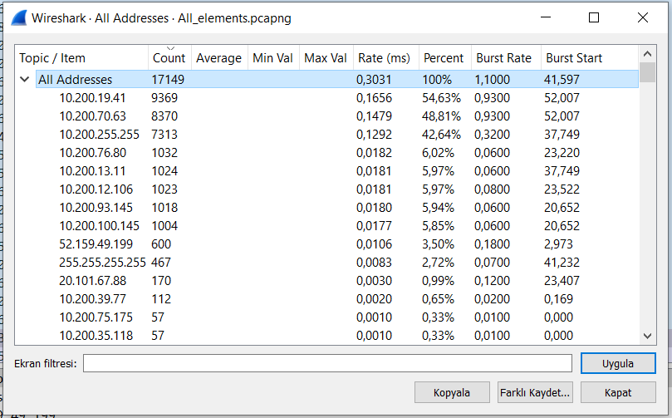
All IP Addresses

Slide 14
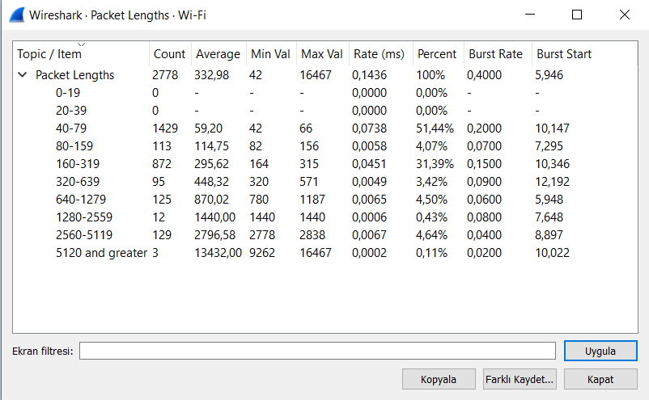
Package Behavior and Features During Chat

Slide 15
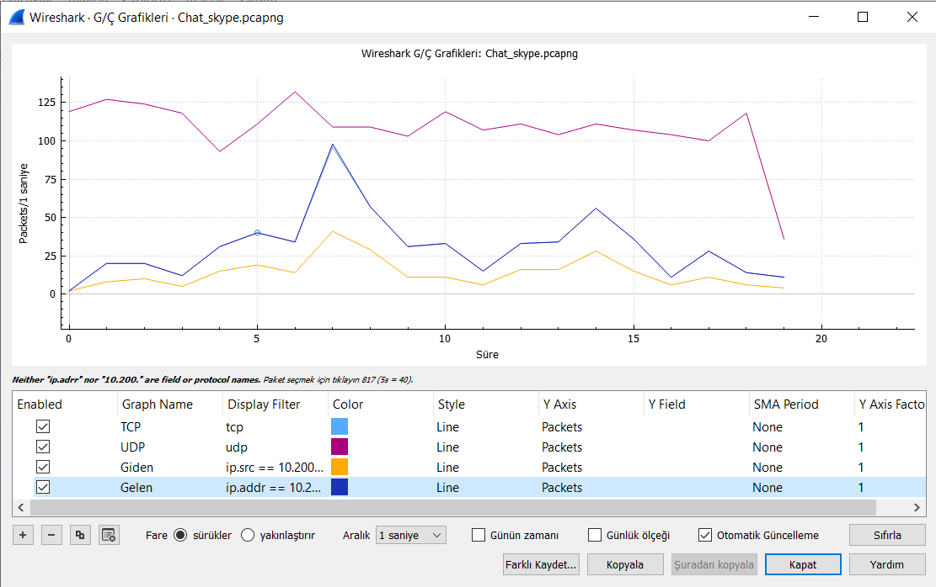
TCP and UDP Behavior for Chat

Slide 16
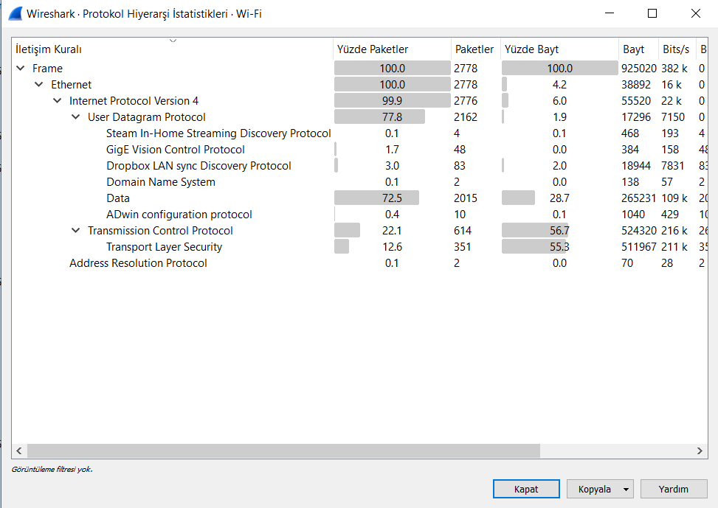
Protocol Hierarchy for Chat

Slide 17
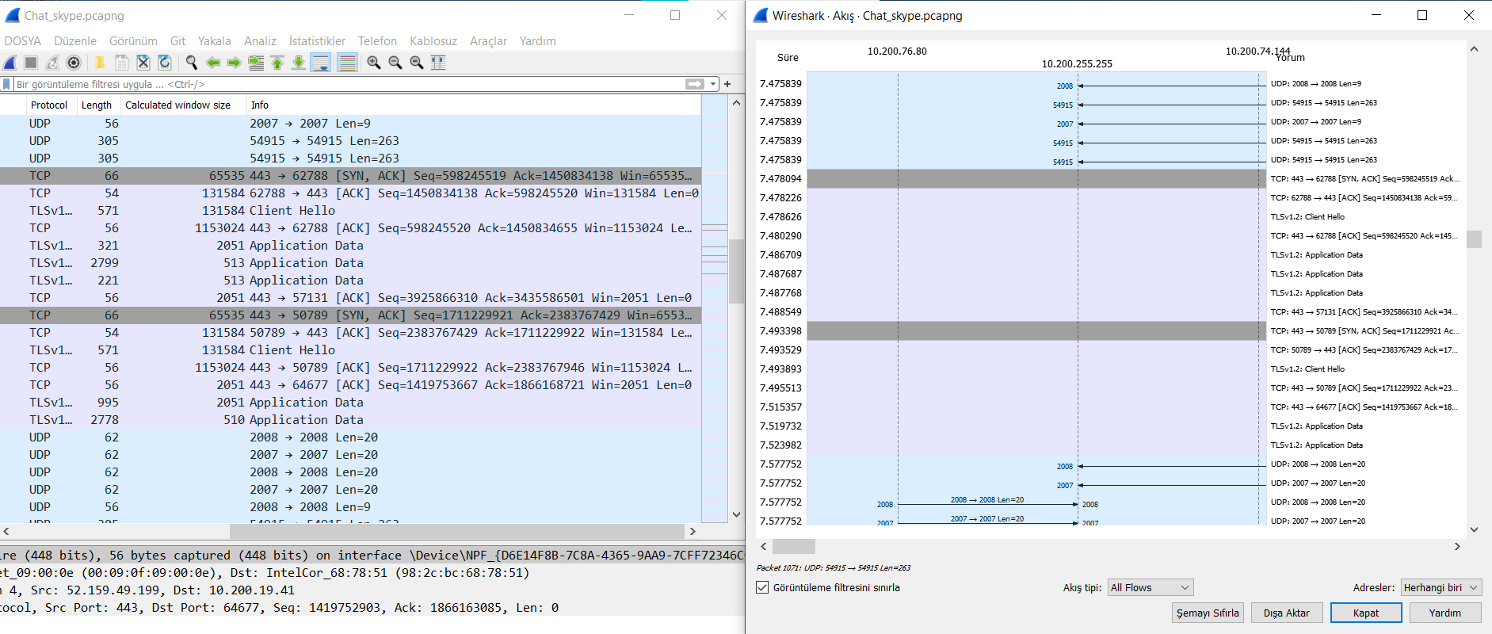

Slide 18
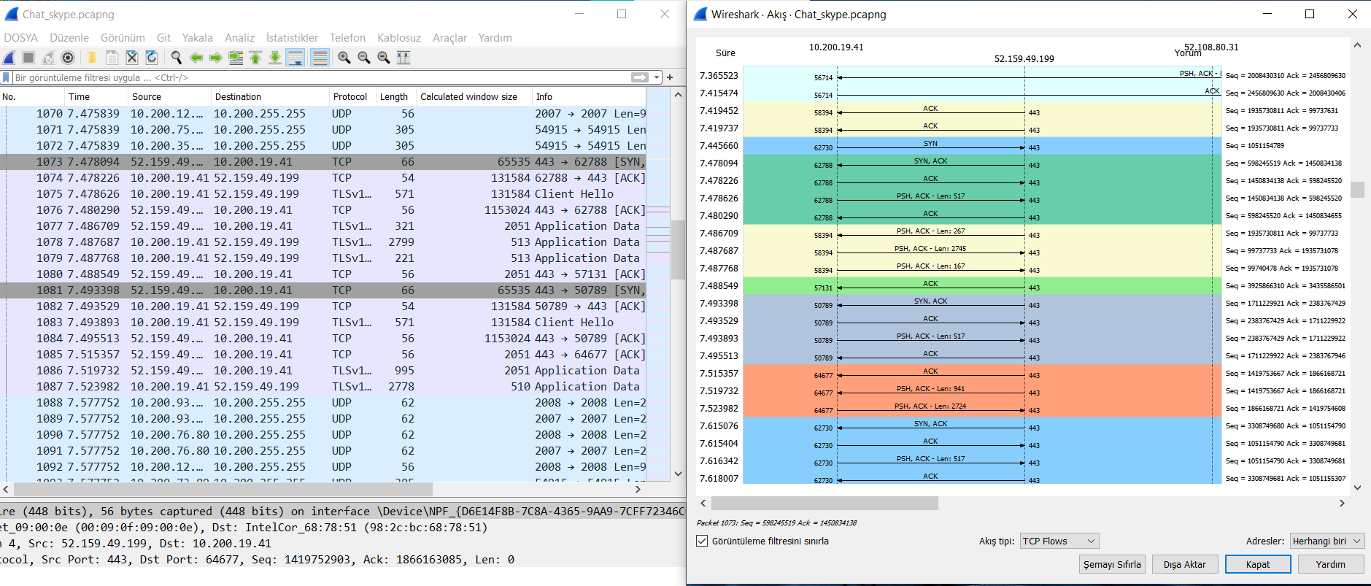

Slide 19
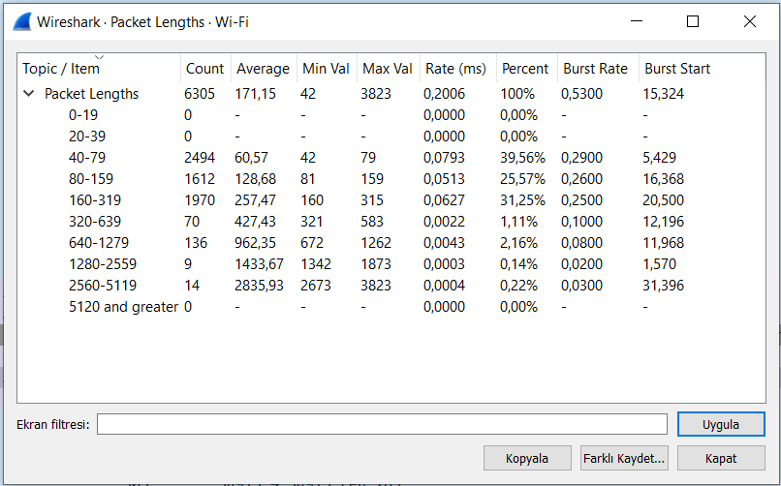
Package Behavior and Features During Voice Calls

Slide 20
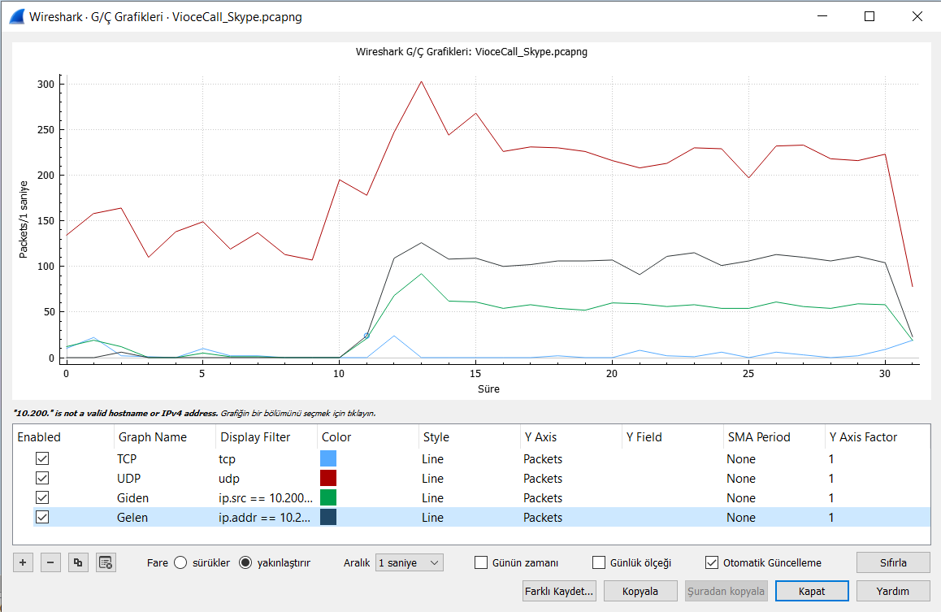
TCP and UDP Behavior for Voice Call

Slide 21
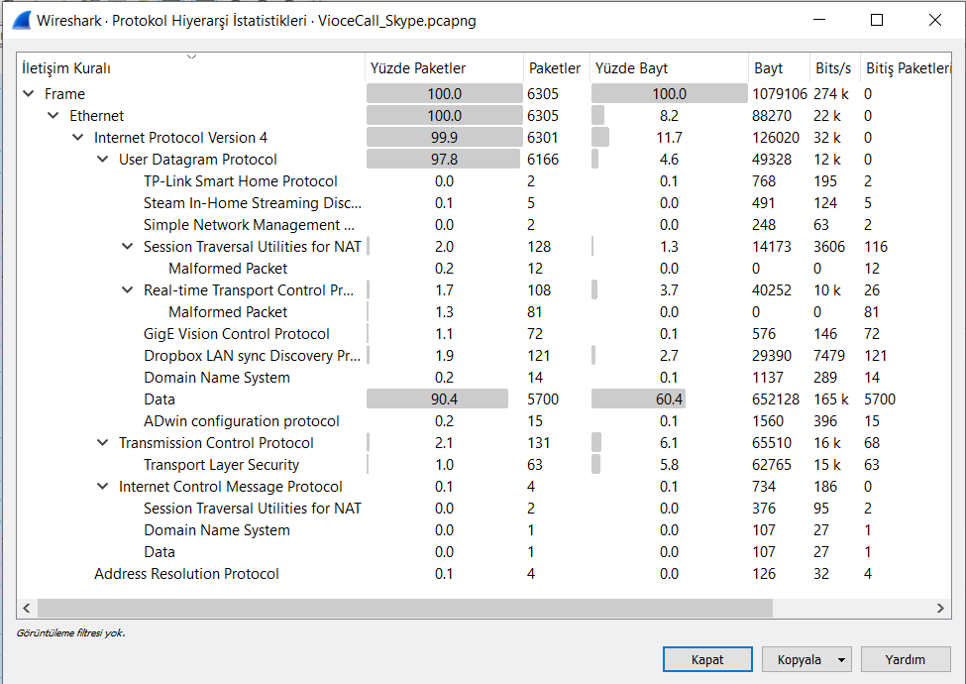
Protocol Hierarchy for Voice Call

Slide 22
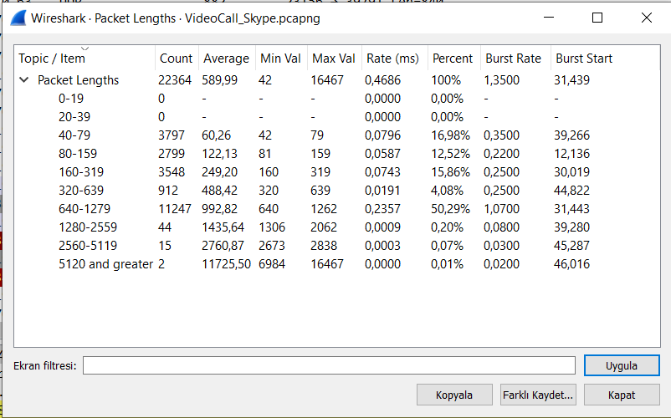
Package Behavior and Features During Video Calls

Slide 23
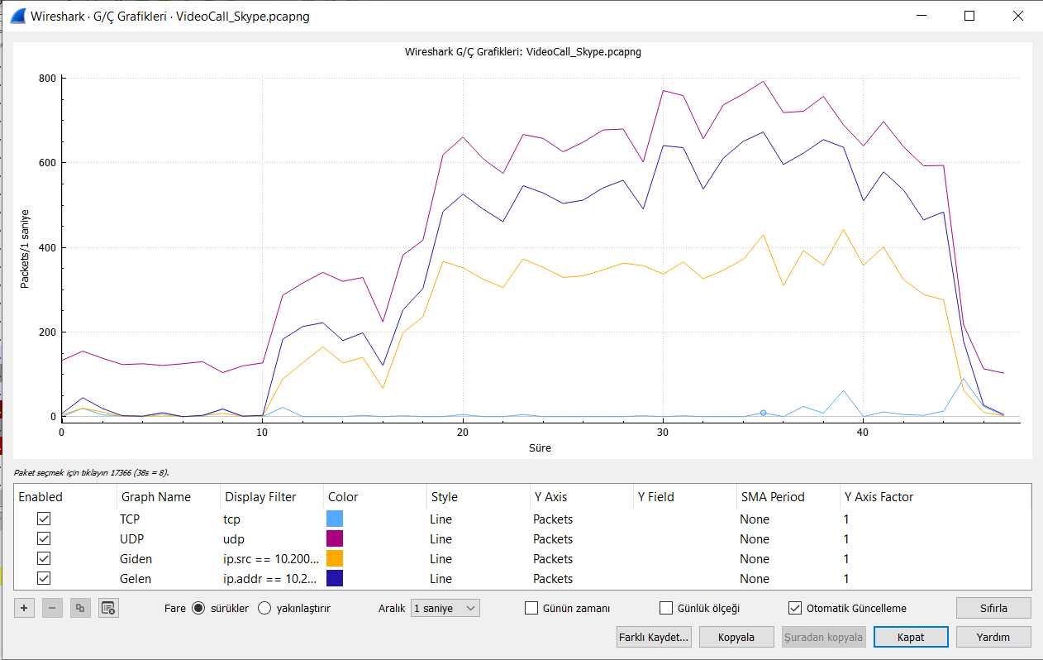
TCP and UDP Behavior for Video Call

Slide 24
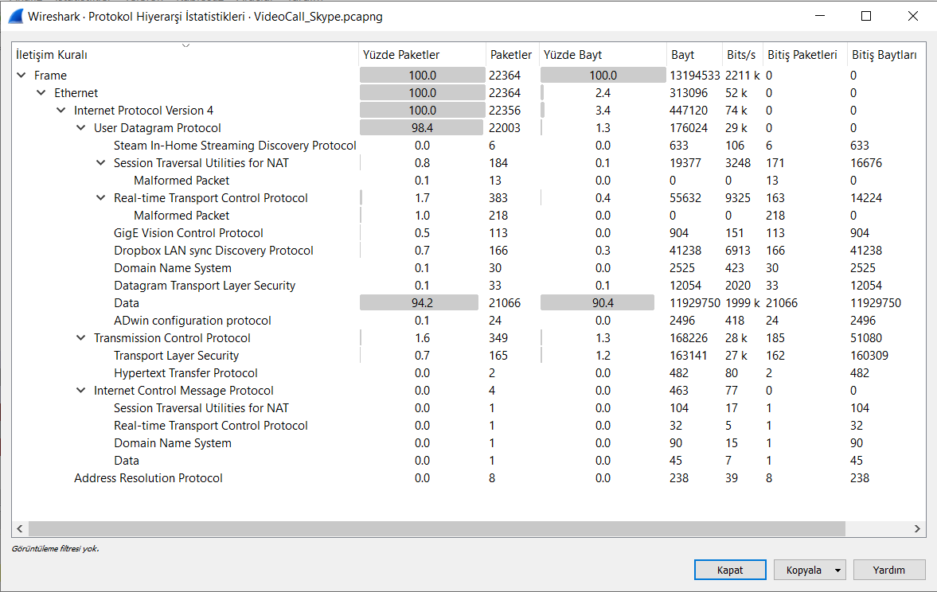
Protocol Hierarchy for Video Call

Slide 25
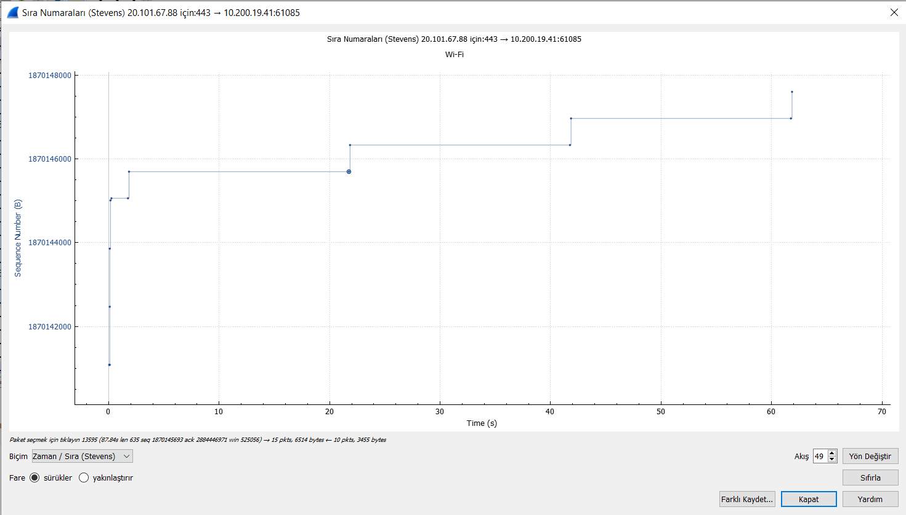
TCP Stream Graph

Slide 26
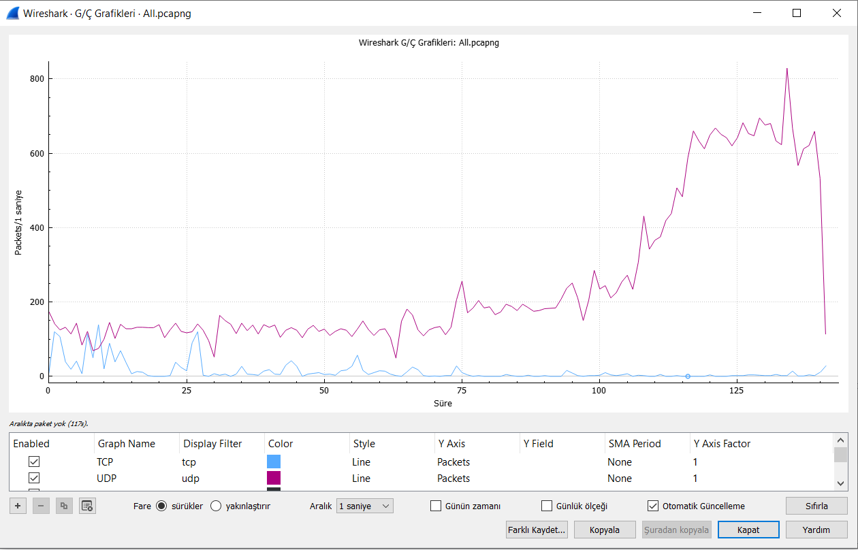
TCP and UDP Behavior for All

Slide 27
Result
For Voice Call:
api.flightproxy.skype.com (10.251.5.1)
For Video Call:
api.flightproxy.skype.com (10.251.5.1)
Packet Sizes
When sending text messages, much smaller packets are transported, but in video and voice calls, the packets are larger.
Protocol Hierarchy
Skype uses wideband codecs which allows it to maintain reasonable call quality at an available bandwidth of 32 kb/s. It uses TCP for signaling, and both UDP and TCP for transporting media traffic.

Slide 28
References
https://www.techtarget.com/searchunifiedcommunications/definition/Skype-protocol#:~:text=Skype%20requires%20that%20Ports%2080,prefers%20UDP%20for%20voice%20transmissions
https://en.wikipedia.org/wiki/Skype_protocol
http://www.oklabs.net/skype-reverse-engineering-the-long-journey/
http://www.oklabs.net/skype-protocol-reverse-engineered-video/
https://wiki.wireshark.org/Skype
https://github.com/matthiasbock/OpenSkype/wiki/Skype%27s-UDP-Format

